Slide 1
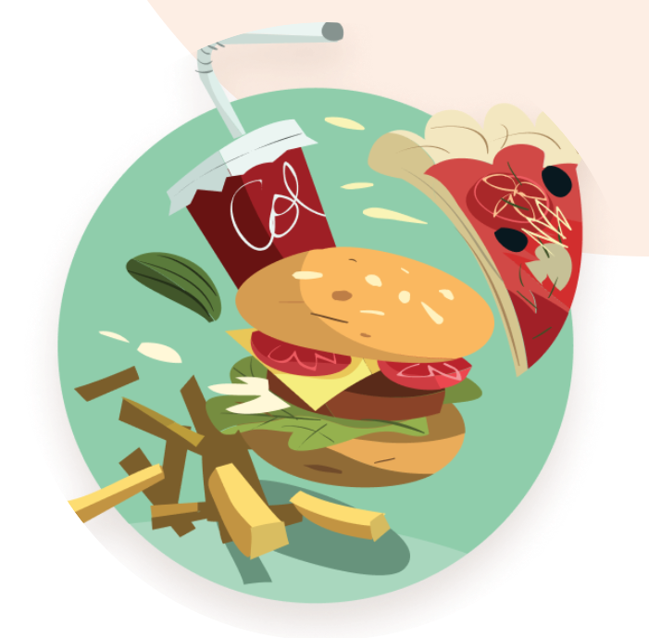
FOOD TIME
Order Food any Time
Name : Anshuman Kumar
Roll No : 1901037
Supervised by : Dr. Angshuman Jana

Slide 2

Outline
Introduction
Motivation
Objective
Scope
Functionalities
Design Flow
Implementation
Current Status
Future Work

Slide 3
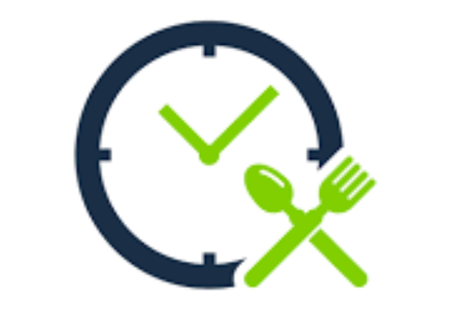
Introduction
The online food ordering system is one of the latest servicers being used in most of the restaurants.
With this method, food is ordered online and delivered to the customer.
With the help of online payment methods, customers get more flexibility.
So, the system designed in this project will enable customers go online and place order for their favorite food at cheapest price.

Slide 4
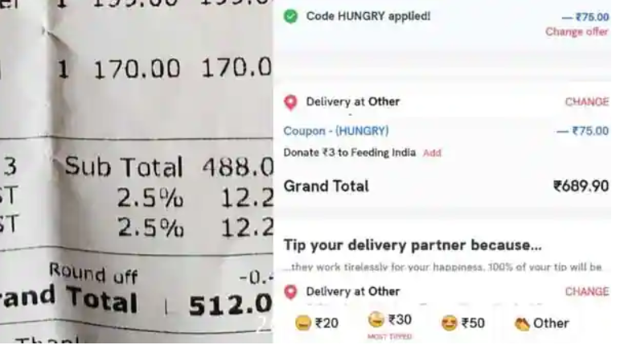
Motivation
This is the Bill of 1-time meal.
As a result existing systems are not feasible for daily base orders especially for students.
Existing Systems : Zomato, and Swiggy
Well maintained app
Provide extremely great features and UI
BUT
Taxes and Charges are very high
Delivery time is very high
Can’t be feasible for small orders

Slide 5

Objective
An online platform where you can get your favorite food at the cheapest price.
Provide great UI and easy to use.
No delivery charges.
Check food Status via chat bot
Best fitted for small orders
The objective of developing Food-Time is to allow users to go through all the dishes available at the nearby restaurant present nearby institute.
Place orders and get them delivered with less cost and time according to their convenience.

Slide 6
Scope
Reducing long queues of customers at the counter
Reducing the workload of the employees at the nearby restaurants.
These food stalls will be able to update their menu and rates of the available foods also.
Improved and efficient services are provided to the customers by the inclusion of the internet in the business.

Slide 7
Functionalities
❖ Log In: Restaurants and Clients can login by entering usernames and passwords and managing their work on a website.
❖ Save information: The client enters all the necessary information by filling out a personal info form and the system save that information.
❖ Change requirements: Customers can change any of their information at any time.
❖ Food Menu: Restaurants can insert, update and delete the food items from the menu list.
❖ Chat bot : User can check their current status of food.
❖Cancelation : User can cancel their onder within a certain amount of time without any cancelation charges.
❖ Modify the Menu: Restaurants can add or remove different dishes.
❖ View Orders: Restaurants can view the placed order and delivered orders.

Slide 8
Non Functional Requirement
❖ Efficient: In case of clashes of order, it places the order in the queue on the basis of order time.
❖ Safety: Data in the database of the system should not be lost or damaged.
❖ Privacy: Personal data of the system should not be disclosed to anyone.
❖ Security: Secure access to confidential data (customer information).

Slide 9
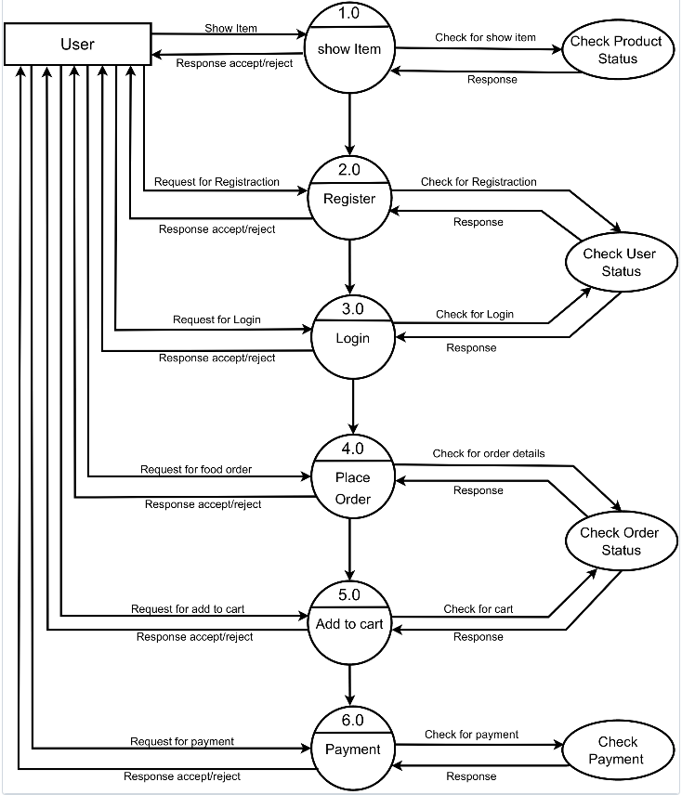

Design Flow
Data Flow Diagram

Slide 10
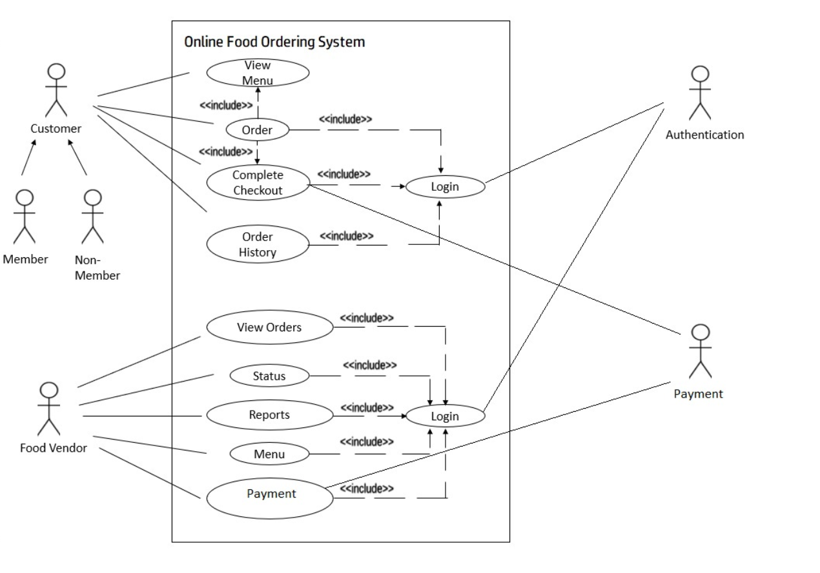
Use Case Diagram

Slide 11
Implementation
Backend : Node.js with Express.js
Frontend : React.js
Database : MongoDB
Language : Javascript
We have used MERN stack to implement this system

Slide 12
Current Status
Future Work
Database schema is created successfully.
Backend part for login, food ordering is ready
Frontend login page is ready
Working on homepage
Backend will be hosted soon
Will add chat-bot system
Will finish frontend part
Test and Deploy the fronted system

Slide 13


